Slide 1
Unit 4
STAFFING

Slide 2
staffing
Staffing refers to assigning men to the organisation structure
Staffing involves determination of man-power requirement, recruitment, selection, placement, training, development, job transfer and performance appraisal.

Slide 3
Nature of staffing
Staffing function ensures that results are achieved through others.
It avoids the following functions
- Hiring the wrong person for the job
- Wasting time and money in selection of employees
- Having the company taken to court
- Lack of training which undermines department effectiveness

Slide 4
Importance and need fo staffing
The importance of staffing is a separate function and involves the following
Practicing managers think organizing as just setting up a structure
It brings together the human assets and organizational design
Emphasis on procuring and maintaining Human resources
It is the quality of manpower that determines the efficiency

Slide 5
Functions of ManPower Planning
The following are the functions of manpower planning
It helps to identify the talent and potential of employees
Matching the job and the person
Ensures right number of people which helps in the smooth flow of activities
It ensures proper utilisation of human resources
Gives an idea for the internal succession of managerial positions

Slide 6
Manpower planning process
The steps related to Human resource planning process are
Demand forecasting – estimating the future needs of human resources as per company’s plans
2. Supply forecasting – estimating the supply of human resources from the recruitment pool
3. Determining Human resource requirements
4. Productivity and cost analysis of Human resources with respect to utilization and cost.
5. Action planning of the necessary programmes of recruitment, selection, training and development etc
6. Human resource budgeting and control

Slide 7
motivation
Motivation is the inner state that causes an individual to behave in a way that ensures accomplishment of some goal
Generally two methods of motivation are used to motivate people
1. Financial motivation and
2. Non-financial motivation

Slide 8
Importance of Motivation
Increases performance level
Adaptability to changing organizational climate
Lower turnover of employees
Effectiveness of performance on the job.

Slide 9
Theories of Motivation
The important theories of Motivation are
Maslow’s need Hierarchy
Herzberg’s Two Factor theory
Achievement Motivation theory
ERG theory
Expectancy theory
Equity theory
Reinforcement theory
McGregor’s theory X and theory Y.

Slide 10
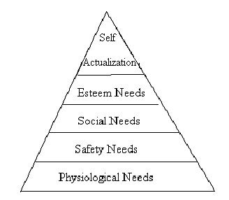
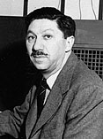
Maslow’s need Hierarchy

Slide 11



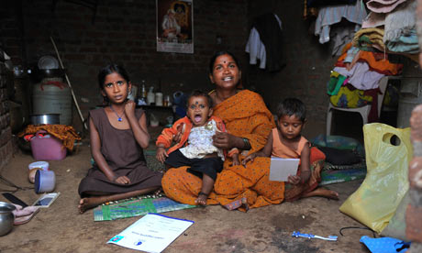
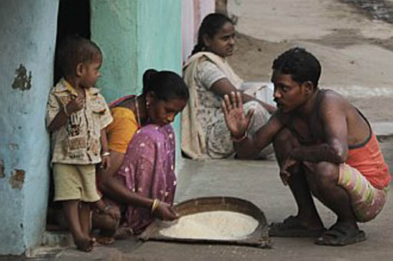
Self actualization
Esteem Needs
Social Needs
Safety Needs
Physiological Needs

Slide 12
2. Herzberg’s Two Factor theory
Two factor responsible for motivation are
Satisfiers or motivators and
Hygiene factors or maintenance factors or dissatisfiers
Hygiene factors | Motivators
Company policy Supervision Relationship with supervisors Work condition Salary Relationship with co-workers | Achievement Recognition Work itself Responsibility Advancement Growth

Slide 13
3. Achievement Motivation theory
Main elements of this theory are
Need for achievement
Need for power and
Need for affiliation

Slide 14
4. ERG theory
Clayton Alderfer formulated a needs-category model in line with empirical evidence. Like Maslow and Herzberg, Alderfer felt that there was a basic distinction between lower-order needs and higher – order needs.
Alderfer identified three groups of core needs:
Existence Needs: They are concerned with survival [physiological well–being]
Related needs: They stress the importance of interpersonal and social relationship.
Growth needs: They are concerned with the individual’s intrinsic [inner] desire for personal development.

Slide 15
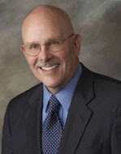
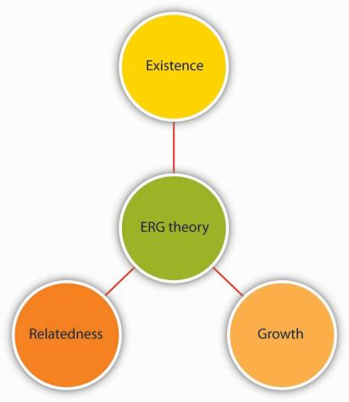
Clayton Alderfer

Slide 16
5. Expectancy theory
This approach has three elements
Performance outcome expectancy
Valence
Efforts performance expectancy

Slide 17
6. Equity theory
The essence of this theory is that employees working in organizations make comparisons of their efforts and rewards with others.
This theory is based on three assumptions that all should be treated equally in terms of justice, balance and fairness.

Slide 18
7. Reinforcement theory
This theory emphasis four aspects
Stimulus
Response
Consequence and future

Slide 19
8. McGregor’s theory X and theory Y.
After observing how managers deal with their employees, Douglas McGregor proposed Theory X and Theory Y. According to McGregor,
Theory X assumes that employees dislike work and responsibility and they are also lazy. They must be coerced to perform.
Theory Y assumes that employees like work, they are creative, seek responsibility and can exercise self–direction.

Slide 20
morale
Morale has different meanings
Mayo defined Morale as “the maintenance of cooperative living”
The components of morale are
Intrinsic job satisfaction
Satisfaction with the company
Satisfaction with supervision
Satisfaction with rewards
Satisfaction with co-workers

Slide 21
The factors affecting Morale
The organisation
Leadership
Co-workers
The nature of work
Work environment
The employee

Slide 22
Morale building
Remuneration
Job security
Participation
Job enrichment
Organisation structure
Grievance redressal
Employee counsellors
Sound leadership

Slide 23
leadership
According to Stephen P. Robbins, leadership is the ability to influence a group towards the achievement of a vision or set of goals.

Slide 24
Manager characteristics | Leader characteristics
Administers | Innovates
A copy | An original
Maintains | Develops
Focuses on systems / structure | Focuses on people
Relies on control | Inspires trust
Short range view | Long ranges view
Asks how and when | Asks what and why
Eye on the bottom line | Eye on the horizon
Imitates | Originates
Accepts the status quo | Challenges the status quo
Classic good soldier | Own person
Does things right [efficient] | Does the right thing [effective]
Orders | Coaches / advises
Authority | Confidence / goodwill
Fear | Enthusiasm
Finding fault | Solving problems
Assumes he knows all | Consults / seeks advice
Makes work drudgery | Work is a game
Believes in “I” | Believes in “we” and “ you”

Slide 25
Qualities of a leader
Qualities of a leader can be explained base on the traits and skills required by the leader

Slide 26
Trait characteristics of successful leaders
Adaptability to changing situations
Alertness to changing social environment
Ambitious and achievement record
Assertiveness
Reliable and dependable
Desire to influence
Self confidence
Ability to cope with stress
Willing to take up responsibility and accountability

Slide 27
Skills required by successful leaders
High influence
Persuasive
Personal, impersonal and negotiation skills
Creative
Diplomatic and tactful
Excellent communication skills
Administrative capability
Be able to identify problems

Slide 28
Functions of a leader
Leader develops network
Leader is a representative of the subordinates
Leader is an appropriate counsellor
Leader uses power properly
Leader uses time well
Leader strives for effectiveness

Slide 29
Importance of leadership
inspires employees
Secures cooperation
Creates confidence
Provides good working climate

Slide 30
Leadership styles
`The behaviour exhibited by the leader during the supervision of subordinates is known as leadership style.
Basically there are three leadership styles
1. Directive, Autocratic or Authoritarian
2. Participative or democratic style and
3. laissez-faire or Free-rein leadership

